Slide 1
Livestock Skillathon
Retail Meat Cuts Identification #1

Slide 2
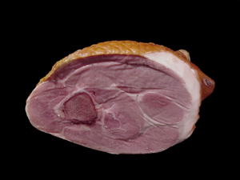
#1
Beef,Brisket, flat half
Lamb, Breast, Denver Style ribs
Pork, Ham, Fresh center slice
Beef, Brisket, whole
Lamb, Leg, American style roast
Pork, Ham, Fresh rump portion
Beef, Chuck, arm roast
Lamb, Leg, center slice
Pork, Ham, Fresh shank portion
Beef, Chuck, arm roast, boneless
Lamb, Leg, French style roast
Pork, Loin, blade chop
Beef, Chuck, blade roast
Lamb, Leg, sirloin chop
Pork, Loin, blade roast

Slide 3
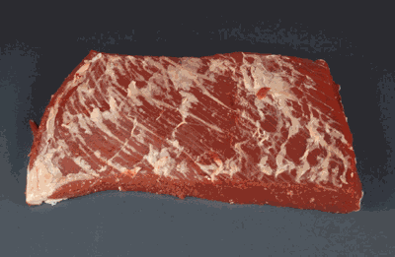
#2
Beef,Brisket, flat half
Lamb, Breast, Denver Style ribs
Pork, Ham, Fresh center slice
Beef, Brisket, whole
Lamb, Leg, American style roast
Pork, Ham, Fresh rump portion
Beef, Chuck, arm roast
Lamb, Leg, center slice
Pork, Ham, Fresh shank portion
Beef, Chuck, arm roast, boneless
Lamb, Leg, French style roast
Pork, Loin, blade chop
Beef, Chuck, blade roast
Lamb, Leg, sirloin chop
Pork, Loin, blade roast

Slide 4
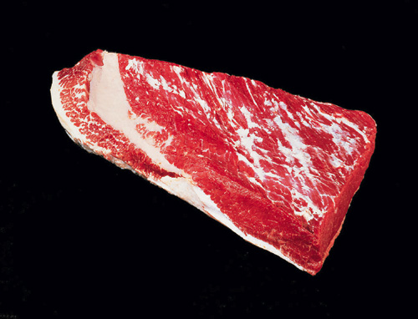
#3
Beef,Brisket, flat half
Lamb, Breast, Denver Style ribs
Pork, Ham, Fresh center slice
Beef, Brisket, whole
Lamb, Leg, American style roast
Pork, Ham, Fresh rump portion
Beef, Chuck, arm roast
Lamb, Leg, center slice
Pork, Ham, Fresh shank portion
Beef, Chuck, arm roast, boneless
Lamb, Leg, French style roast
Pork, Loin, blade chop
Beef, Chuck, blade roast
Lamb, Leg, sirloin chop
Pork, Loin, blade roast

Slide 5
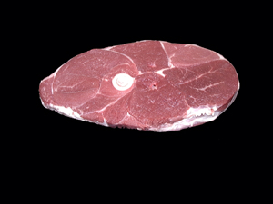
#4
Beef,Brisket, flat half
Lamb, Breast, Denver Style ribs
Pork, Ham, Fresh center slice
Beef, Brisket, whole
Lamb, Leg, American style roast
Pork, Ham, Fresh rump portion
Beef, Chuck, arm roast
Lamb, Leg, center slice
Pork, Ham, Fresh shank portion
Beef, Chuck, arm roast, boneless
Lamb, Leg, French style roast
Pork, Loin, blade chop
Beef, Chuck, blade roast
Lamb, Leg, sirloin chop
Pork, Loin, blade roast

Slide 6
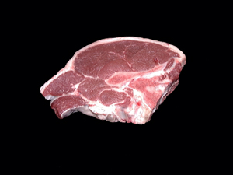
#5
Beef,Brisket, flat half
Lamb, Breast, Denver Style ribs
Pork, Ham, Fresh center slice
Beef, Brisket, whole
Lamb, Leg, American style roast
Pork, Ham, Fresh rump portion
Beef, Chuck, arm roast
Lamb, Leg, center slice
Pork, Ham, Fresh shank portion
Beef, Chuck, arm roast, boneless
Lamb, Leg, French style roast
Pork, Loin, blade chop
Beef, Chuck, blade roast
Lamb, Leg, sirloin chop
Pork, Loin, blade roast

Slide 7
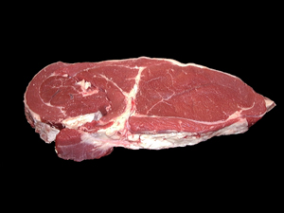
#6
Beef,Brisket, flat half
Lamb, Breast, Denver Style ribs
Pork, Ham, Fresh center slice
Beef, Brisket, whole
Lamb, Leg, American style roast
Pork, Ham, Fresh rump portion
Beef, Chuck, arm roast
Lamb, Leg, center slice
Pork, Ham, Fresh shank portion
Beef, Chuck, arm roast, boneless
Lamb, Leg, French style roast
Pork, Loin, blade chop
Beef, Chuck, blade roast
Lamb, Leg, sirloin chop
Pork, Loin, blade roast

Slide 8
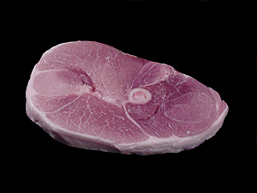
#7
Beef,Brisket, flat half
Lamb, Breast, Denver Style ribs
Pork, Ham, Fresh center slice
Beef, Brisket, whole
Lamb, Leg, American style roast
Pork, Ham, Fresh rump portion
Beef, Chuck, arm roast
Lamb, Leg, center slice
Pork, Ham, Fresh shank portion
Beef, Chuck, arm roast, boneless
Lamb, Leg, French style roast
Pork, Loin, blade chop
Beef, Chuck, blade roast
Lamb, Leg, sirloin chop
Pork, Loin, blade roast

Slide 9
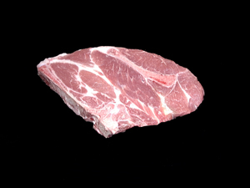
#8
Beef,Brisket, flat half
Lamb, Breast, Denver Style ribs
Pork, Ham, Fresh center slice
Beef, Brisket, whole
Lamb, Leg, American style roast
Pork, Ham, Fresh rump portion
Beef, Chuck, arm roast
Lamb, Leg, center slice
Pork, Ham, Fresh shank portion
Beef, Chuck, arm roast, boneless
Lamb, Leg, French style roast
Pork, Loin, blade chop
Beef, Chuck, blade roast
Lamb, Leg, sirloin chop
Pork, Loin, blade roast

Slide 10
Answers
Pork, Ham, Fresh shank portion
Beef,Brisket, flat half
Beef, Brisket, whole
Lamb, Leg, center slice
Lamb, Leg, sirloin chop
Beef, Chuck, arm roast, boneless
Pork, Ham, Fresh center slice
Pork, Loin, blade chop

