Slide 1
Livestock Skillathon
Meats Judging #1
Place each class based on muscling, trimness and quality.

Slide 2
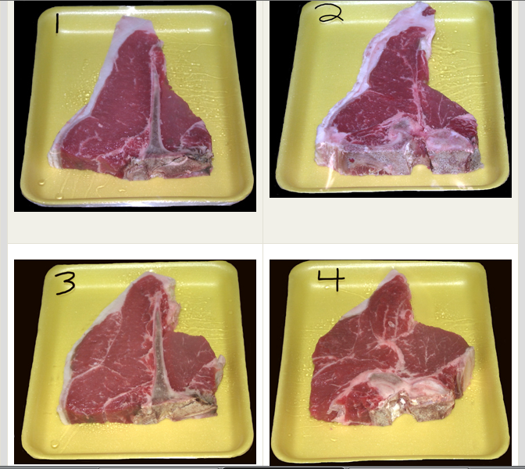
#1 – Beef T-Bone Steak Class

Slide 3
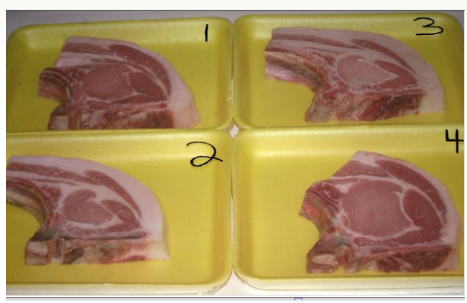
#2 – Pork Rib Chop Class

Slide 4
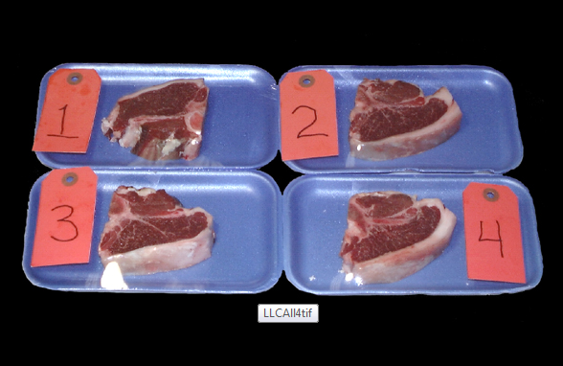
#3 – Lamb Loin Chop Class

Slide 5
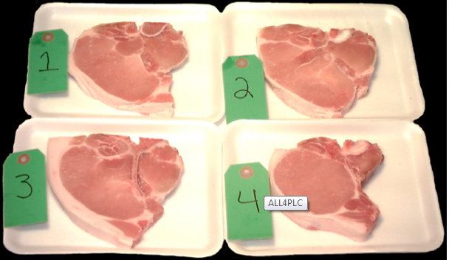
#4 – Pork Loin Chop Class

Slide 6
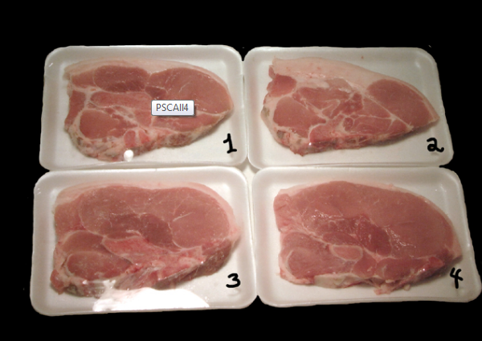
#5 – Pork Sirloin Chop Class

Slide 7
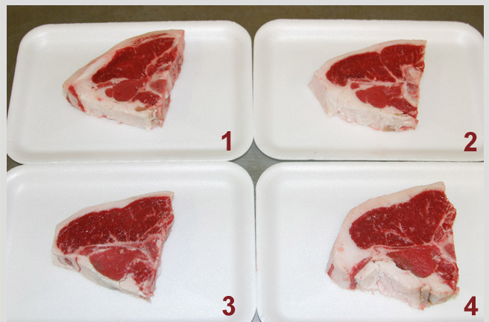
#6 – Lamb Loin Chop Class 2

Slide 8
Official Placings
Beef T-Bone Steak 4 – 3 – 1 – 2
Pork Rib Chop 4 – 1 – 3 – 2
Lamb Loin Chop 3 – 1 – 2 – 4
Pork Loin Chop 2 – 1 – 4 – 3
Pork Sirloin Chop 4 – 3 – 1 – 2
Lamb Loin Chop #2 3 – 2 – 4 – 1

