Slide 1
Livestock Skillathon
Feedstuff Identification #2

Slide 2
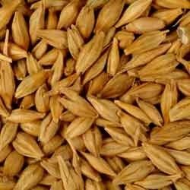
1. Identify the following feedstuff.
A. Whole Soybean
B. Whole Wheat
C. Whole Barley

Slide 3
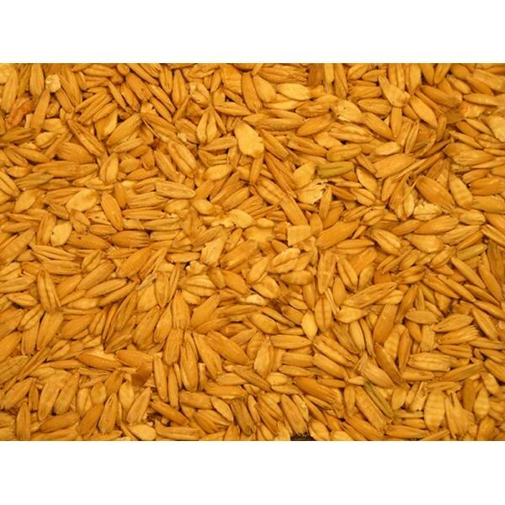
2. Identify the following feedstuff.
A. Crimped Oats
B. Wheat Bran
C. Steamed Flaked Corn

Slide 4
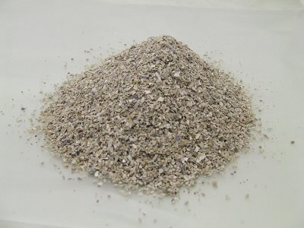
3. Identify the following feedstuff.
A. Oyster Shells
B. Meat & Bone Meal
C. Ground Limestone

Slide 5
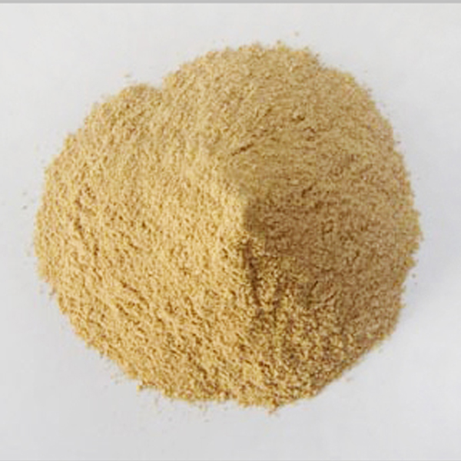
4. Identify the following feedstuff.
A. L-tryptophan
B. Fish Meal
C. Sunflower Meal

Slide 6
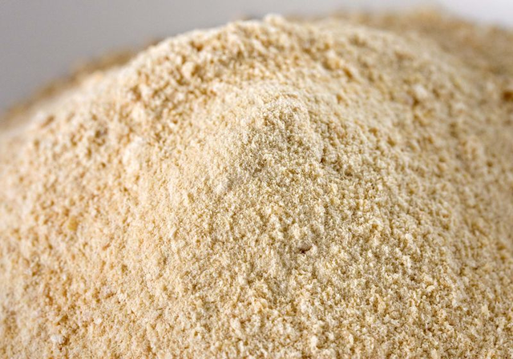
5. Identify the following feedstuff.
A. Salt, white
B. Linseed Meal
C. Ground Ear Corn

Slide 7
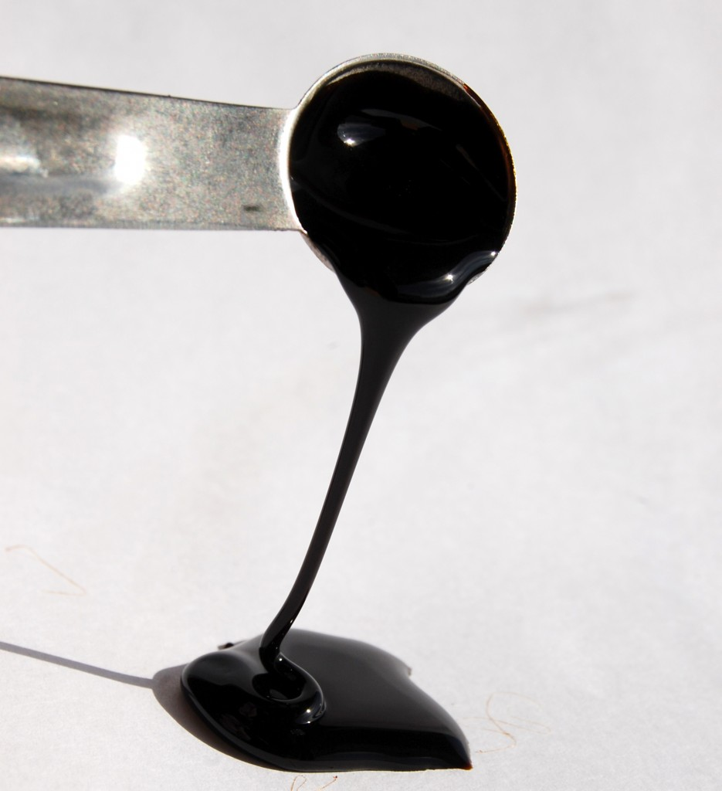
5. Identify the following feedstuff.
A. Vegetable Oil
B. Liquid Molasses
C. L-Lysine HCL

Slide 8
Answers
1. C. Barley (whole)
2. A. Crimped oats
3. A. Oyster shells
4. B. Fish meal
5. C. Ground ear corn
6. B. Liquid molasses

