Slide 1
Livestock Skillathon
Livestock Equipment Identification #1

Slide 2
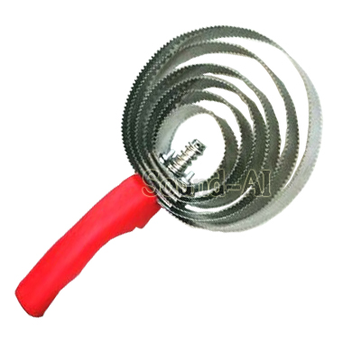
All-in-one castrator/docker
Artificial insemination pipettes
Bowl waterer
Balling gun
Barnes dehorner
Cattle clippers
Clipper comb
Clipper cutter
Currycomb
Disposable syringes
Drench gun
Ear notchers
Ear tag pliers
Elastrator
Electric branding iron
Electric dehorner
Electric docker
Emasculator
Ewe prolapse retainer
Fencing pliers
#1

Slide 3
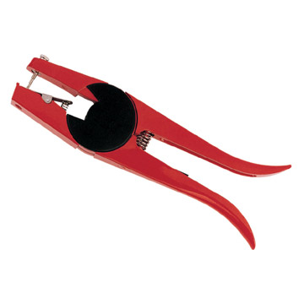
All-in-one castrator/docker
Artificial insemination pipettes
Bowl waterer
Balling gun
Barnes dehorner
Cattle clippers
Clipper comb
Clipper cutter
Currycomb
Disposable syringes
Drench gun
Ear notchers
Ear tag pliers
Elastrator
Electric branding iron
Electric dehorner
Electric docker
Emasculator
Ewe prolapse retainer
Fencing pliers
#2

Slide 4
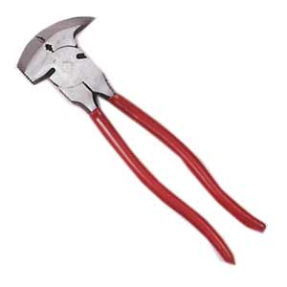
All-in-one castrator/docker
Artificial insemination pipettes
Bowl waterer
Balling gun
Barnes dehorner
Cattle clippers
Clipper comb
Clipper cutter
Currycomb
Disposable syringes
Drench gun
Ear notchers
Ear tag pliers
Elastrator
Electric branding iron
Electric dehorner
Electric docker
Emasculator
Ewe prolapse retainer
Fencing pliers
#3

Slide 5
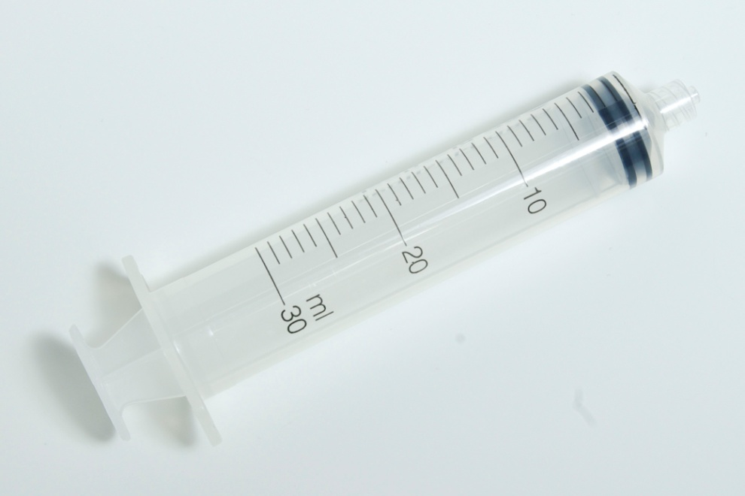
All-in-one castrator/docker
Artificial insemination pipettes
Bowl waterer
Balling gun
Barnes dehorner
Cattle clippers
Clipper comb
Clipper cutter
Currycomb
Disposable syringes
Drench gun
Ear notchers
Ear tag pliers
Elastrator
Electric branding iron
Electric dehorner
Electric docker
Emasculator
Ewe prolapse retainer
Fencing pliers
#4

Slide 6
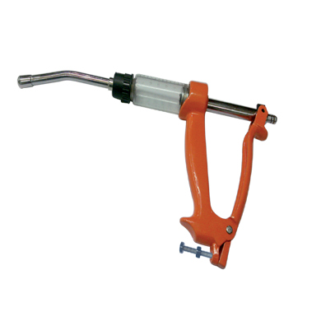
#5
All-in-one castrator/docker
Artificial insemination pipettes
Bowl waterer
Balling gun
Barnes dehorner
Cattle clippers
Clipper comb
Clipper cutter
Currycomb
Disposable syringes
Drench gun
Ear notchers
Ear tag pliers
Elastrator
Electric branding iron
Electric dehorner
Electric docker
Emasculator
Ewe prolapse retainer
Fencing pliers

Slide 7
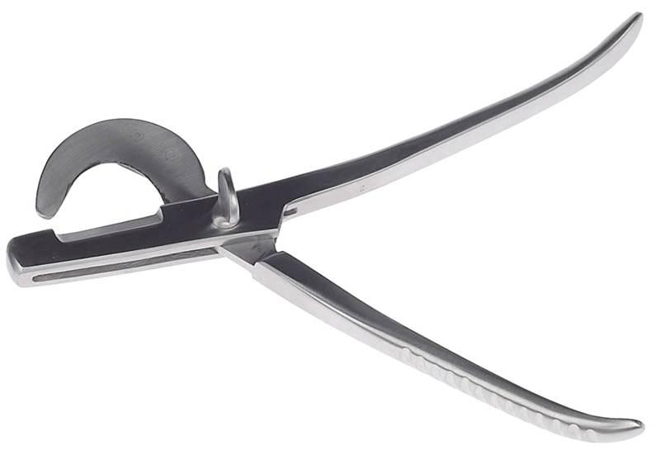
#6
All-in-one castrator/docker
Artificial insemination pipettes
Bowl waterer
Balling gun
Barnes dehorner
Cattle clippers
Clipper comb
Clipper cutter
Currycomb
Disposable syringes
Drench gun
Ear notchers
Ear tag pliers
Elastrator
Electric branding iron
Electric dehorner
Electric docker
Emasculator
Ewe prolapse retainer
Fencing pliers

Slide 8
Answers
Equipment #1
#1 - Curry comb
#2 – Ear tag pliers
#3 – Fencing pliers
#4 – Disposable syringe
#5 - Drenching gun
#6 - Emasculator
Notes:
Cheviot

