Slide 1
Livestock Skillathon
Retail Meat Cuts Identification #3

Slide 2
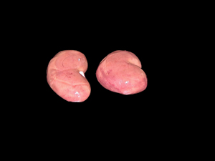
#1
Beef, Variety Meat, heart
Beef, Variety Meat, kidney
Beef, Variety Meat, liver
Beef, Variety Meat, oxtails
Beef, Variety Meat, tongue
Beef, Variety Meat, tripe
Lamb, Variety Meat, heart
Lamb, Variety Meat, kidney
Lamb, Variety Meat, liver
Lamb, Variety Meat, tongue
Pork, Variety Meat, heart
Pork, Variety Meat, kidney
Pork, Variety Meat, liver
Pork, Variety Meat, tongue

Slide 3
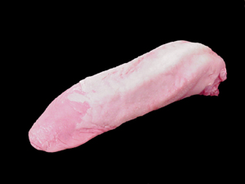
#2
Beef, Variety Meat, heart
Beef, Variety Meat, kidney
Beef, Variety Meat, liver
Beef, Variety Meat, oxtails
Beef, Variety Meat, tongue
Beef, Variety Meat, tripe
Lamb, Variety Meat, heart
Lamb, Variety Meat, kidney
Lamb, Variety Meat, liver
Lamb, Variety Meat, tongue
Pork, Variety Meat, heart
Pork, Variety Meat, kidney
Pork, Variety Meat, liver
Pork, Variety Meat, tongue

Slide 4
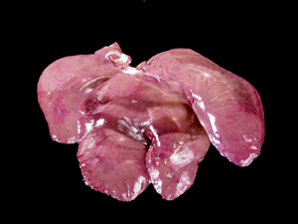
#3
Beef, Variety Meat, heart
Beef, Variety Meat, kidney
Beef, Variety Meat, liver
Beef, Variety Meat, oxtails
Beef, Variety Meat, tongue
Beef, Variety Meat, tripe
Lamb, Variety Meat, heart
Lamb, Variety Meat, kidney
Lamb, Variety Meat, liver
Lamb, Variety Meat, tongue
Pork, Variety Meat, heart
Pork, Variety Meat, kidney
Pork, Variety Meat, liver
Pork, Variety Meat, tongue

Slide 5
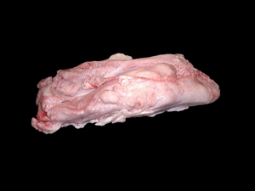
#4
Beef, Variety Meat, heart
Beef, Variety Meat, kidney
Beef, Variety Meat, liver
Beef, Variety Meat, oxtails
Beef, Variety Meat, tongue
Beef, Variety Meat, tripe
Lamb, Variety Meat, heart
Lamb, Variety Meat, kidney
Lamb, Variety Meat, liver
Lamb, Variety Meat, tongue
Pork, Variety Meat, heart
Pork, Variety Meat, kidney
Pork, Variety Meat, liver
Pork, Variety Meat, tongue

Slide 6
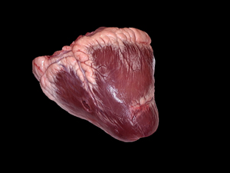
#5
Beef, Variety Meat, heart
Beef, Variety Meat, kidney
Beef, Variety Meat, liver
Beef, Variety Meat, oxtails
Beef, Variety Meat, tongue
Beef, Variety Meat, tripe
Lamb, Variety Meat, heart
Lamb, Variety Meat, kidney
Lamb, Variety Meat, liver
Lamb, Variety Meat, tongue
Pork, Variety Meat, heart
Pork, Variety Meat, kidney
Pork, Variety Meat, liver
Pork, Variety Meat, tongue

Slide 7
#6
Beef, Variety Meat, heart
Beef, Variety Meat, kidney
Beef, Variety Meat, liver
Beef, Variety Meat, oxtails
Beef, Variety Meat, tongue
Beef, Variety Meat, tripe
Lamb, Variety Meat, heart
Lamb, Variety Meat, kidney
Lamb, Variety Meat, liver
Lamb, Variety Meat, tongue
Pork, Variety Meat, heart
Pork, Variety Meat, kidney
Pork, Variety Meat, liver
Pork, Variety Meat, tongue

Slide 8
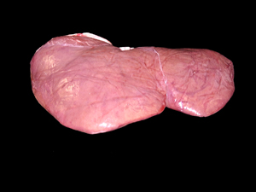
#7
Beef, Variety Meat, heart
Beef, Variety Meat, kidney
Beef, Variety Meat, liver
Beef, Variety Meat, oxtails
Beef, Variety Meat, tongue
Beef, Variety Meat, tripe
Lamb, Variety Meat, heart
Lamb, Variety Meat, kidney
Lamb, Variety Meat, liver
Lamb, Variety Meat, tongue
Pork, Variety Meat, heart
Pork, Variety Meat, kidney
Pork, Variety Meat, liver
Pork, Variety Meat, tongue

Slide 9
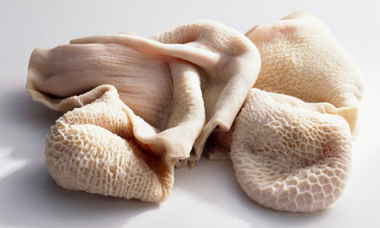
#8
Beef, Variety Meat, heart
Beef, Variety Meat, kidney
Beef, Variety Meat, liver
Beef, Variety Meat, oxtails
Beef, Variety Meat, tongue
Beef, Variety Meat, tripe
Lamb, Variety Meat, heart
Lamb, Variety Meat, kidney
Lamb, Variety Meat, liver
Lamb, Variety Meat, tongue
Pork, Variety Meat, heart
Pork, Variety Meat, kidney
Pork, Variety Meat, liver
Pork, Variety Meat, tongue

Slide 10
Answers
Lamb, Variety Meat, kidney
Pork, Variety Meat, tongue
Pork, Variety Meat, liver
Beef, Variety Meat, oxtails
Beef, Variety Meat, heart
Pork, Variety Meat, heart
Lamb, Variety Meat, liver
Beef, Variety Meat, tripe

