Slide 1
Livestock Skillathon
Retail Meat Cuts Identification #2

Slide 2
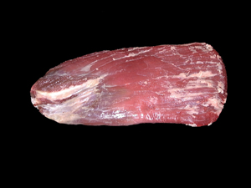
#1
Beef, Chuck, 7-bone roast
Lamb, Leg, sirloin half
Pork,Loin, butterfly chop
Beef, Flank, steak
Lamb, Rack, rib chop
Pork, Loin, center rib roast
Lamb, Loin, sirloin steak, boneless
Lamb, Rack, rib chop frenched
Pork, Loin, center loin roast
Beef, Loin, tenderloin steak
Lamb, Rack, rib roast
Pork, Loin, loin chop
Beef, Loin, porterhouse steak
Lamb, Rack, rib roast frenched
Pork, Loin, rib chop

Slide 3
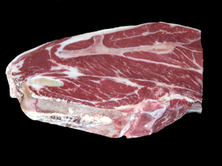
#2
Beef, Chuck, 7-bone roast
Lamb, Leg, sirloin half
Pork,Loin, butterfly chop
Beef, Flank, steak
Lamb, Rack, rib chop
Pork, Loin, center rib roast
Lamb, Loin, sirloin steak, boneless
Lamb, Rack, rib chop frenched
Pork, Loin, center loin roast
Beef, Loin, tenderloin steak
Lamb, Rack, rib roast
Pork, Loin, loin chop
Beef, Loin, porterhouse steak
Lamb, Rack, rib roast frenched
Pork, Loin, rib chop

Slide 4
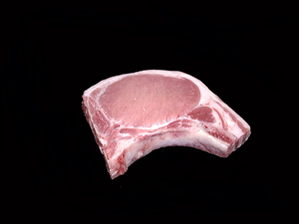
#3
Beef, Chuck, 7-bone roast
Lamb, Leg, sirloin half
Pork,Loin, butterfly chop
Beef, Flank, steak
Lamb, Rack, rib chop
Pork, Loin, center rib roast
Lamb, Loin, sirloin steak, boneless
Lamb, Rack, rib chop frenched
Pork, Loin, center loin roast
Beef, Loin, tenderloin steak
Lamb, Rack, rib roast
Pork, Loin, loin chop
Beef, Loin, porterhouse steak
Lamb, Rack, rib roast frenched
Pork, Loin, rib chop

Slide 5
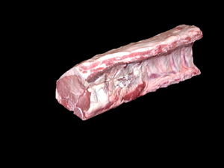
#4
Beef, Chuck, 7-bone roast
Lamb, Leg, sirloin half
Pork,Loin, butterfly chop
Beef, Flank, steak
Lamb, Rack, rib chop
Pork, Loin, center rib roast
Lamb, Loin, sirloin steak, boneless
Lamb, Rack, rib chop frenched
Pork, Loin, center loin roast
Beef, Loin, tenderloin steak
Lamb, Rack, rib roast
Pork, Loin, loin chop
Beef, Loin, porterhouse steak
Lamb, Rack, rib roast frenched
Pork, Loin, rib chop

Slide 6
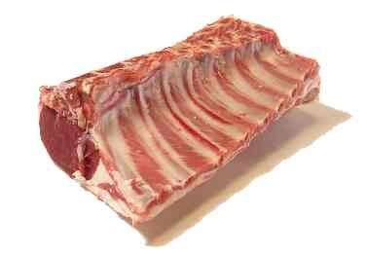
#5
Beef, Chuck, 7-bone roast
Lamb, Leg, sirloin half
Pork,Loin, butterfly chop
Beef, Flank, steak
Lamb, Rack, rib chop
Pork, Loin, center rib roast
Lamb, Loin, sirloin steak, boneless
Lamb, Rack, rib chop frenched
Pork, Loin, center loin roast
Beef, Loin, tenderloin steak
Lamb, Rack, rib roast
Pork, Loin, loin chop
Beef, Loin, porterhouse steak
Lamb, Rack, rib roast frenched
Pork, Loin, rib chop

Slide 7
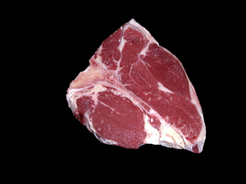
#6
Beef, Chuck, 7-bone roast
Lamb, Leg, sirloin half
Pork,Loin, butterfly chop
Beef, Flank, steak
Lamb, Rack, rib chop
Pork, Loin, center rib roast
Lamb, Loin, sirloin steak, boneless
Lamb, Rack, rib chop frenched
Pork, Loin, center loin roast
Beef, Loin, tenderloin steak
Lamb, Rack, rib roast
Pork, Loin, loin chop
Beef, Loin, porterhouse steak
Lamb, Rack, rib roast frenched
Pork, Loin, rib chop

Slide 8
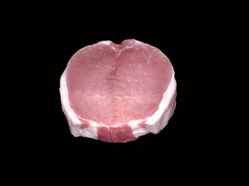
#7
Beef, Chuck, 7-bone roast
Lamb, Leg, sirloin half
Pork,Loin, butterfly chop
Beef, Flank, steak
Lamb, Rack, rib chop
Pork, Loin, center rib roast
Lamb, Loin, sirloin steak, boneless
Lamb, Rack, rib chop frenched
Pork, Loin, center loin roast
Beef, Loin, tenderloin steak
Lamb, Rack, rib roast
Pork, Loin, loin chop
Beef, Loin, porterhouse steak
Lamb, Rack, rib roast frenched
Pork, Loin, rib chop

Slide 9
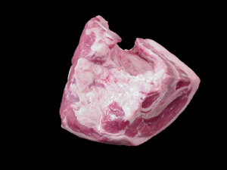
#8
Beef, Chuck, 7-bone roast
Lamb, Leg, sirloin half
Pork,Loin, butterfly chop
Beef, Flank, steak
Lamb, Rack, rib chop
Pork, Loin, center rib roast
Lamb, Loin, sirloin steak, boneless
Lamb, Rack, rib chop frenched
Pork, Loin, center loin roast
Beef, Loin, tenderloin steak
Lamb, Rack, rib roast
Pork, Loin, loin chop
Beef, Loin, porterhouse steak
Lamb, Rack, rib roast frenched
Pork, Loin, rib chop

Slide 10
Answers
Beef, Flank, steak
Beef, Chuck, 7-bone roast
Pork, Loin, rib chop
Pork, Loin, center loin roast
Lamb, Rack, rib roast
Beef, Loin, porterhouse steak
Pork,Loin, butterfly chop
Lamb, Leg, sirloin half

