Slide 1
Livestock Skillathon
Meats Judging #2
Place each class based on muscling, trimness and quality.

Slide 2
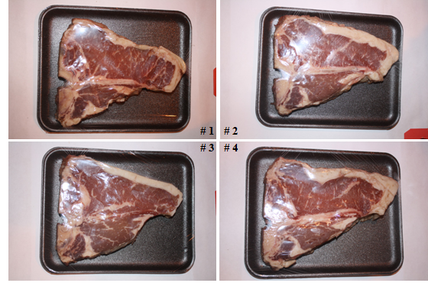
#1 – Beef T-Bone Steak Class

Slide 3
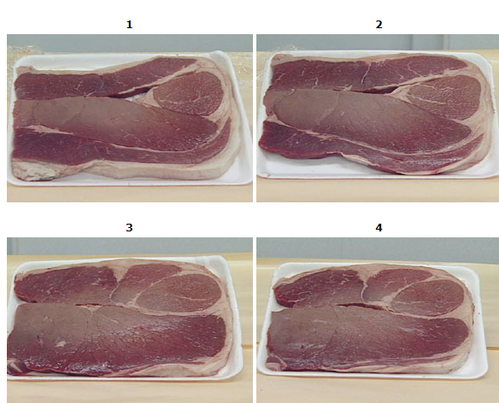
#2 – Beef Rounds Class

Slide 4
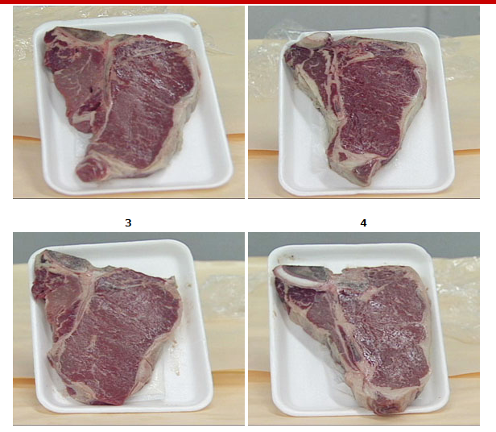
#3 – Beef T-Bones Class

Slide 5
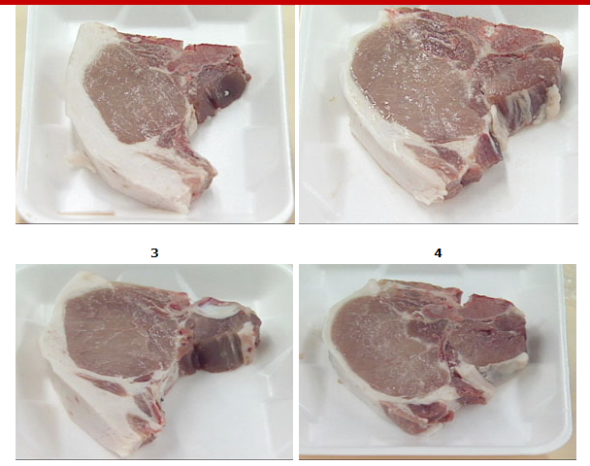
#4 – Pork Loin Chop Class

Slide 6
Official Placings
Beef T-Bone Steak 3 – 2 – 1 – 4
Beef Rounds 3 – 4 – 2 – 1
Beef T-Bones 3 – 1 – 2 – 4
Pork Loin Chop 4 – 2 – 3 – 1

