Slide 1
Livestock Skillathon
Feedstuff Identification #1

Slide 2
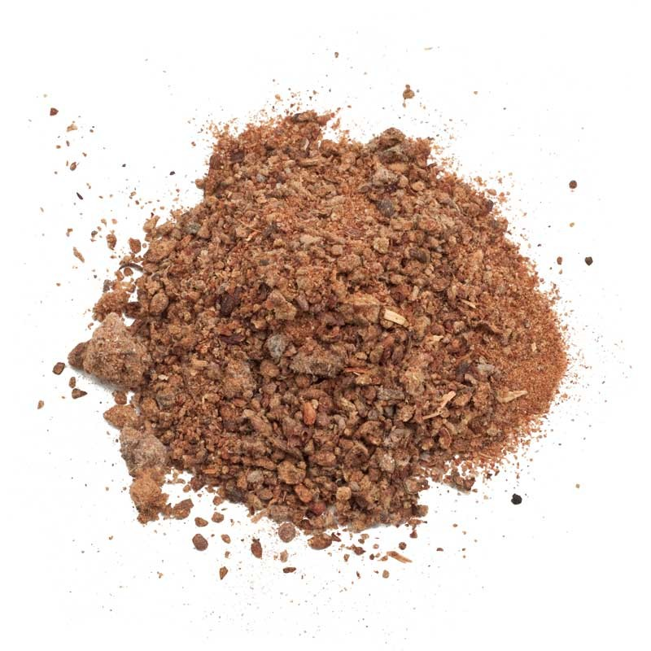
1. Identify the following feedstuff.
A. Alfalfa Meal
B. Cottonseed Meal
C. Feather Meal

Slide 3
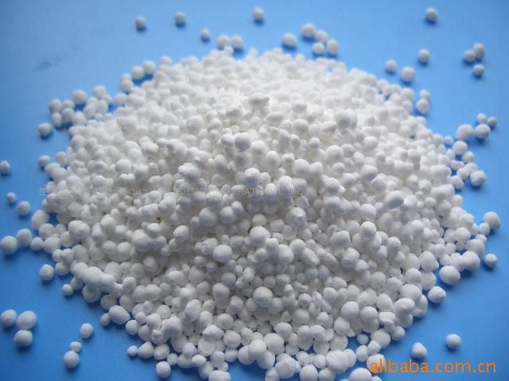
2. Identify the following feedstuff.
A. Potassium Chloride
B. Trace Mineral
Salt
C. Urea

Slide 4
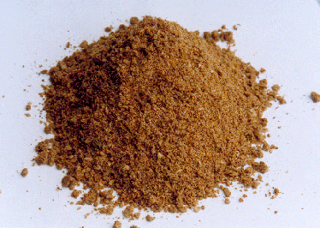
3. Identify the following feedstuff.
A. Feather Meal
B. Meat & Bone Meal
C. Fish Meal

Slide 5
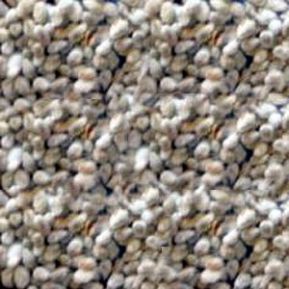
4. Identify the following feedstuff.
A. Cottonseed (whole)
B. Gin Trash
C. Cottonseed Hulls

Slide 6
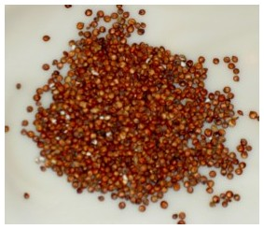
5. Identify the following feedstuff.
A. Milo
B. Beet Pulp
C. Buckwheat

Slide 7
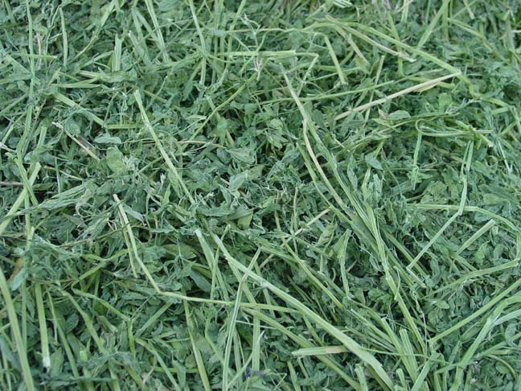
5. Identify the following feedstuff.
A. Alfalfa Hay
B. Brewers Dried Grain
C. Wheat Bran

Slide 8
Answers
1. B. Cottonseed meal
2. C. Urea
3. B. Meat & bone meal
4. A. Cottonseed, whole
5. A. Milo
6. A. Alfalfa hay

