Slide 1
Livestock Skillathon
Livestock Equipment Identification #2

Slide 2
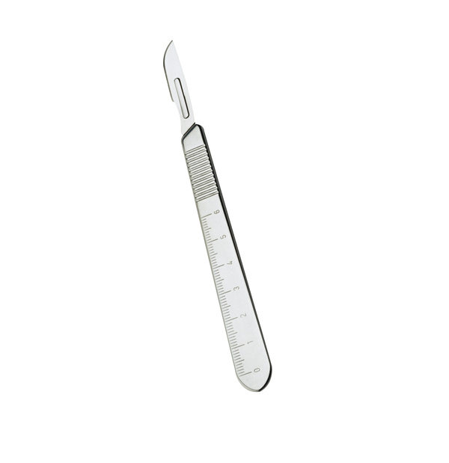
Foot rot shears
Freeze branding iron
Hoof knife
Hog holder (snare)
Lamb tube feeder
Needle teeth nippers
Nipple waterer
Nose ring
Nose ring pliers
Obstetrical (O.B.) chain
Paint branding iron
Pistol-grip syringe
Ram marking harnass
Rumen magnate
Scalpels
Scotch comb
Shearer’s screwdriver
Sheep shears (electric)
Slap tattoo
Tattoo pliers
Wool card
#1

Slide 3
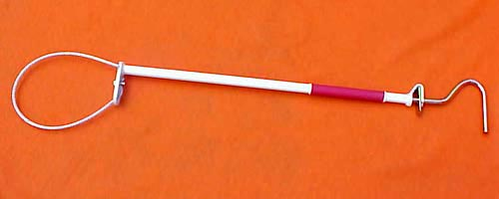
Foot rot shears
Freeze branding iron
Hoof knife
Hog holder (snare)
Lamb tube feeder
Needle teeth nippers
Nipple waterer
Nose ring
Nose ring pliers
Obstetrical (O.B.) chain
Paint branding iron
Pistol-grip syringe
Ram marking harnass
Rumen magnate
Scalpels
Scotch comb
Shearer’s screwdriver
Sheep shears (electric)
Slap tattoo
Tattoo pliers
Wool card
#2

Slide 4
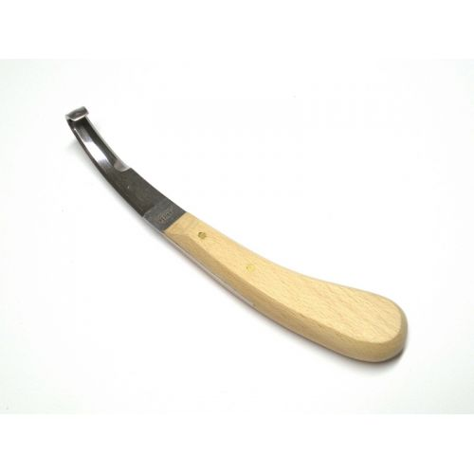
Foot rot shears
Freeze branding iron
Hoof knife
Hog holder (snare)
Lamb tube feeder
Needle teeth nippers
Nipple waterer
Nose ring
Nose ring pliers
Obstetrical (O.B.) chain
Paint branding iron
Pistol-grip syringe
Ram marking harnass
Rumen magnate
Scalpels
Scotch comb
Shearer’s screwdriver
Sheep shears (electric)
Slap tattoo
Tattoo pliers
Wool card
#3

Slide 5
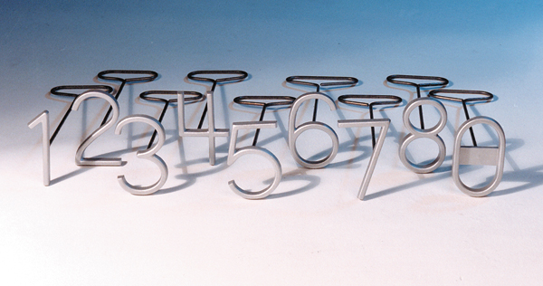
Foot rot shears
Freeze branding iron
Hoof knife
Hog holder (snare)
Lamb tube feeder
Needle teeth nippers
Nipple waterer
Nose ring
Nose ring pliers
Obstetrical (O.B.) chain
Paint branding iron
Pistol-grip syringe
Ram marking harnass
Rumen magnate
Scalpels
Scotch comb
Shearer’s screwdriver
Sheep shears (electric)
Slap tattoo
Tattoo pliers
Wool card
#4

Slide 6
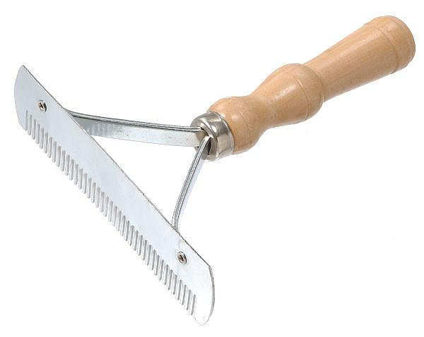
Foot rot shears
Freeze branding iron
Hoof knife
Hog holder (snare)
Lamb tube feeder
Needle teeth nippers
Nipple waterer
Nose ring
Nose ring pliers
Obstetrical (O.B.) chain
Paint branding iron
Pistol-grip syringe
Ram marking harnass
Rumen magnate
Scalpels
Scotch comb
Shearer’s screwdriver
Sheep shears (electric)
Slap tattoo
Tattoo pliers
Wool card
#5

Slide 7
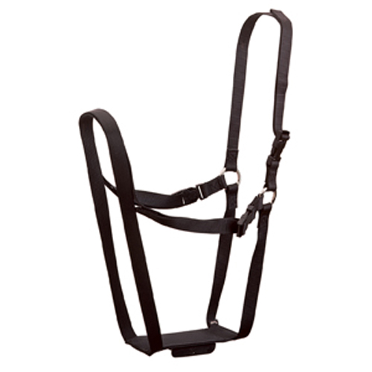
Foot rot shears
Freeze branding iron
Hoof knife
Hog holder (snare)
Lamb tube feeder
Needle teeth nippers
Nipple waterer
Nose ring
Nose ring pliers
Obstetrical (O.B.) chain
Paint branding iron
Pistol-grip syringe
Ram marking harness
Rumen magnate
Scalpels
Scotch comb
Shearer’s screwdriver
Sheep shears (electric)
Slap tattoo
Tattoo pliers
Wool card
#6

Slide 8
Answers
Equipment #1
#1 - Scalpel
#2 – Hog holder (snare)
#3 – Hoof knife
#4 – Paint branding iron
#5 – Scotch comb
#6 – Ram marking harnass
Notes:
Cheviot

