Slide 1
Livestock Skillathon
Livestock Breed Identification

Slide 2
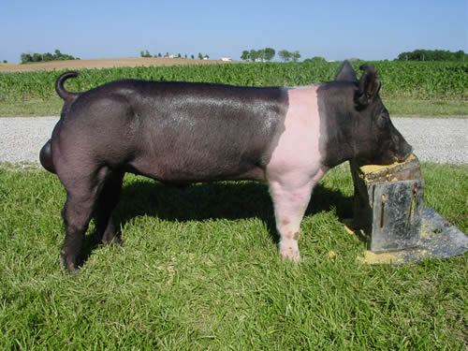
Swine #1
Berkshire
Chester White
Duroc
Hampshire
Hereford
Landrace
Pietrain
Poland China
Spot
Tamworth
Yorkshire

Slide 3
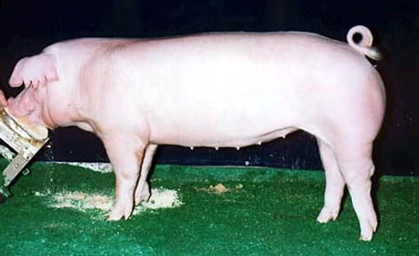
Swine #2
Berkshire
Chester White
Duroc
Hampshire
Hereford
Landrace
Pietrain
Poland China
Spot
Tamworth
Yorkshire

Slide 4
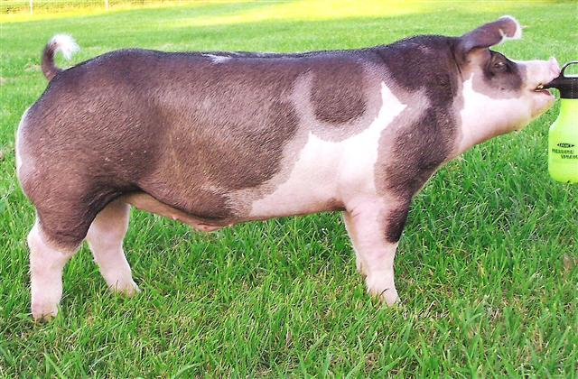
Swine #3
Berkshire
Chester White
Duroc
Hampshire
Hereford
Landrace
Pietrain
Poland China
Spot
Tamworth
Yorkshire

Slide 5
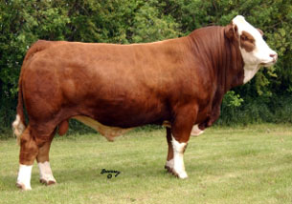
Beef Cattle #1
Angus
Brahman
Brangus
Charolais
Chianina
Gelbvieh
Hereford
Limousin
Longhorn
Maine Anjou
Polled Hereford
Red Angus
Red Poll
Santa Gertrudis
Shorthorn
Simmental
Tarentaise

Slide 6
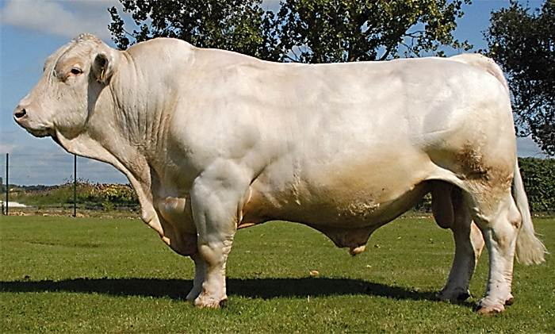
Beef Cattle #2
Angus
Brahman
Brangus
Charolais
Chianina
Gelbvieh
Hereford
Limousin
Longhorn
Maine Anjou
Polled Hereford
Red Angus
Red Poll
Santa Gertrudis
Shorthorn
Simmental
Tarentaise

Slide 7
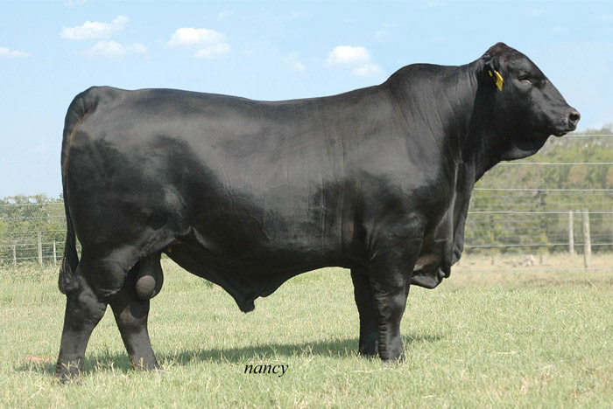
Beef Cattle #3
Angus
Brahman
Brangus
Charolais
Chianina
Gelbvieh
Hereford
Limousin
Longhorn
Maine Anjou
Polled Hereford
Red Angus
Red Poll
Santa Gertrudis
Shorthorn
Simmental
Tarentaise

Slide 8
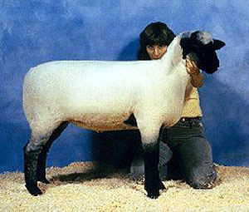
Sheep #1
Cheviot
Columbia
Corriedale
Dorper
Dorset
Finnsheep
Hampshire
Katahdin
Merino
Montadale
Oxford
Polled Dorset
Rambouillet
Romney
Southdown
Suffolk

Slide 9
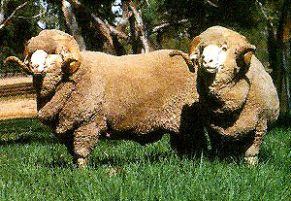
Sheep #2
Cheviot
Columbia
Corriedale
Dorper
Dorset
Finnsheep
Hampshire
Katahdin
Merino
Montadale
Oxford
Polled Dorset
Rambouillet
Romney
Southdown
Suffolk

Slide 10
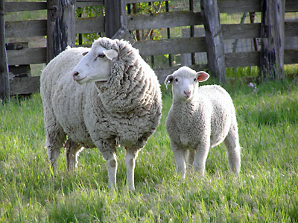
Sheep #3
Cheviot
Columbia
Corriedale
Dorper
Dorset
Finnsheep
Hampshire
Merino
Montadale
Oxford
Rambouillet
Romney
Southdown
Suffolk

Slide 11
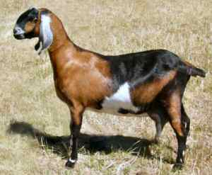
Goat #1
Alpine
American Cashmere
Angora
Boer
Kiko
Lamancha
Nubian
Oberhasli
Pygmy
Saanen
Spanish
Tenessee Fainting
Toggenburg

Slide 12
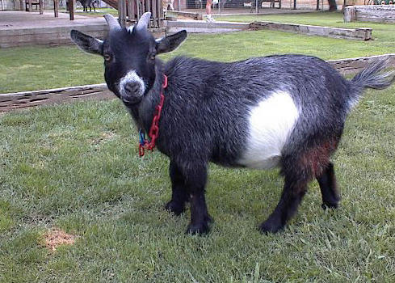
Goat #2
Alpine
American Cashmere
Angora
Boer
Kiko
Lamancha
Nubian
Oberhasli
Pygmy
Saanen
Spanish
Tenessee Fainting
Toggenburg

Slide 13
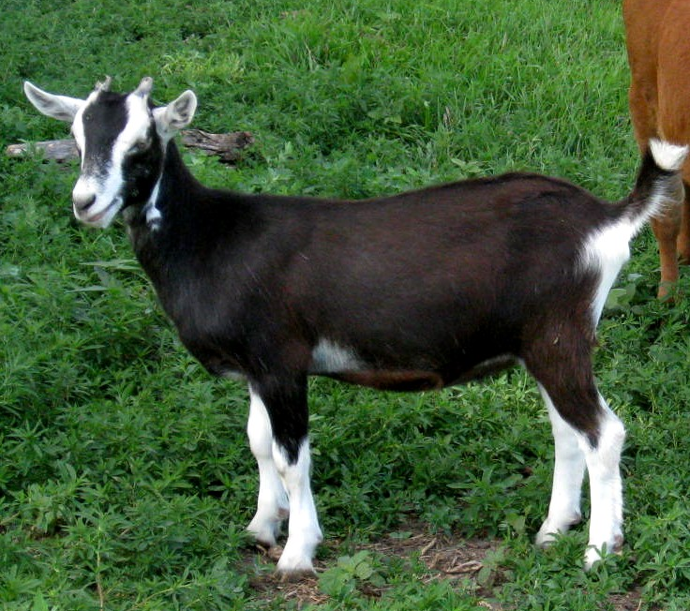
Goat #3
Alpine
American Cashmere
Angora
Boer
Kiko
Lamancha
Nubian
Oberhasli
Pygmy
Saanen
Spanish
Tenessee Fainting
Toggenburg

Slide 14
Answers
SWINE
BEEF CATTLE
SHEEP
#1 - Hampshire
#2 – Chester
White
#3 - Spot
#1 - Simmental
#2 – Charolais
#3 - Brangus
#1 - Hampshire
#2 – Merino
#3 - Columbia
GOATS
#1 - Nubian
#2 – Pygmy
#3 - Alpine
Notes:
Cheviot

